Slide 1
Assignment 6 tutorial: Point Cloud Semantic Segmentation
Instructor: Prof. YU, Yantao
Speaker: Wang Yusen
Department of Civil and Environmental Engineering
The Hong Kong University of Science and Technology

Slide 2
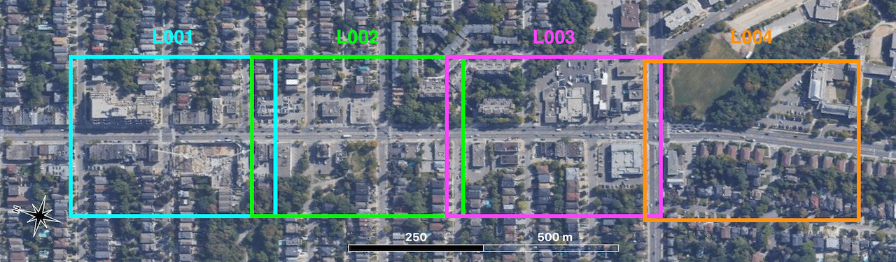
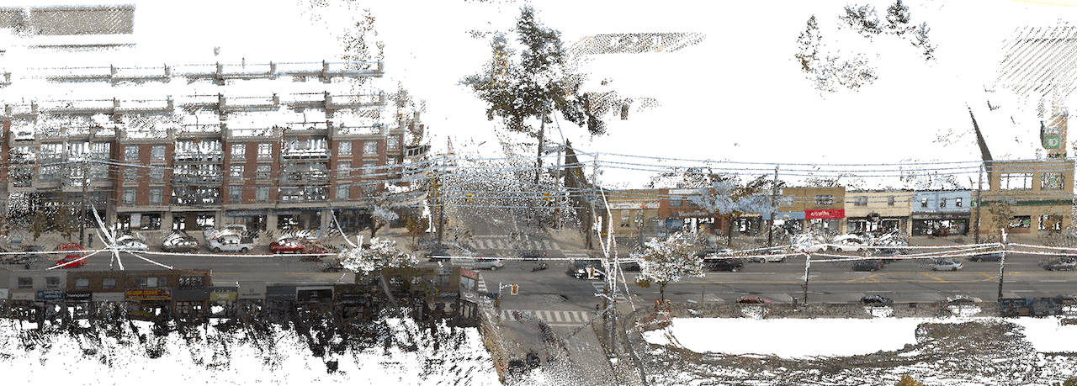

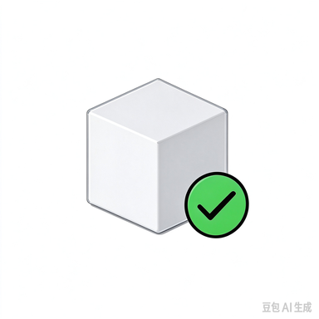

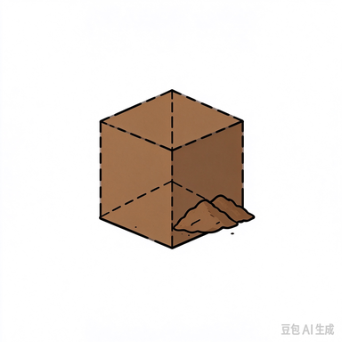



Point Clouds in Civil Engineering
Turning real-world sites into 3D data
Physical Site
Point Cloud
Existing buildings:
How can we document a building when drawings are incomplete?
Construction quality:
Does the built structure match the design?
Earthwork volumes:
How much material was excavated or filled?

Slide 3
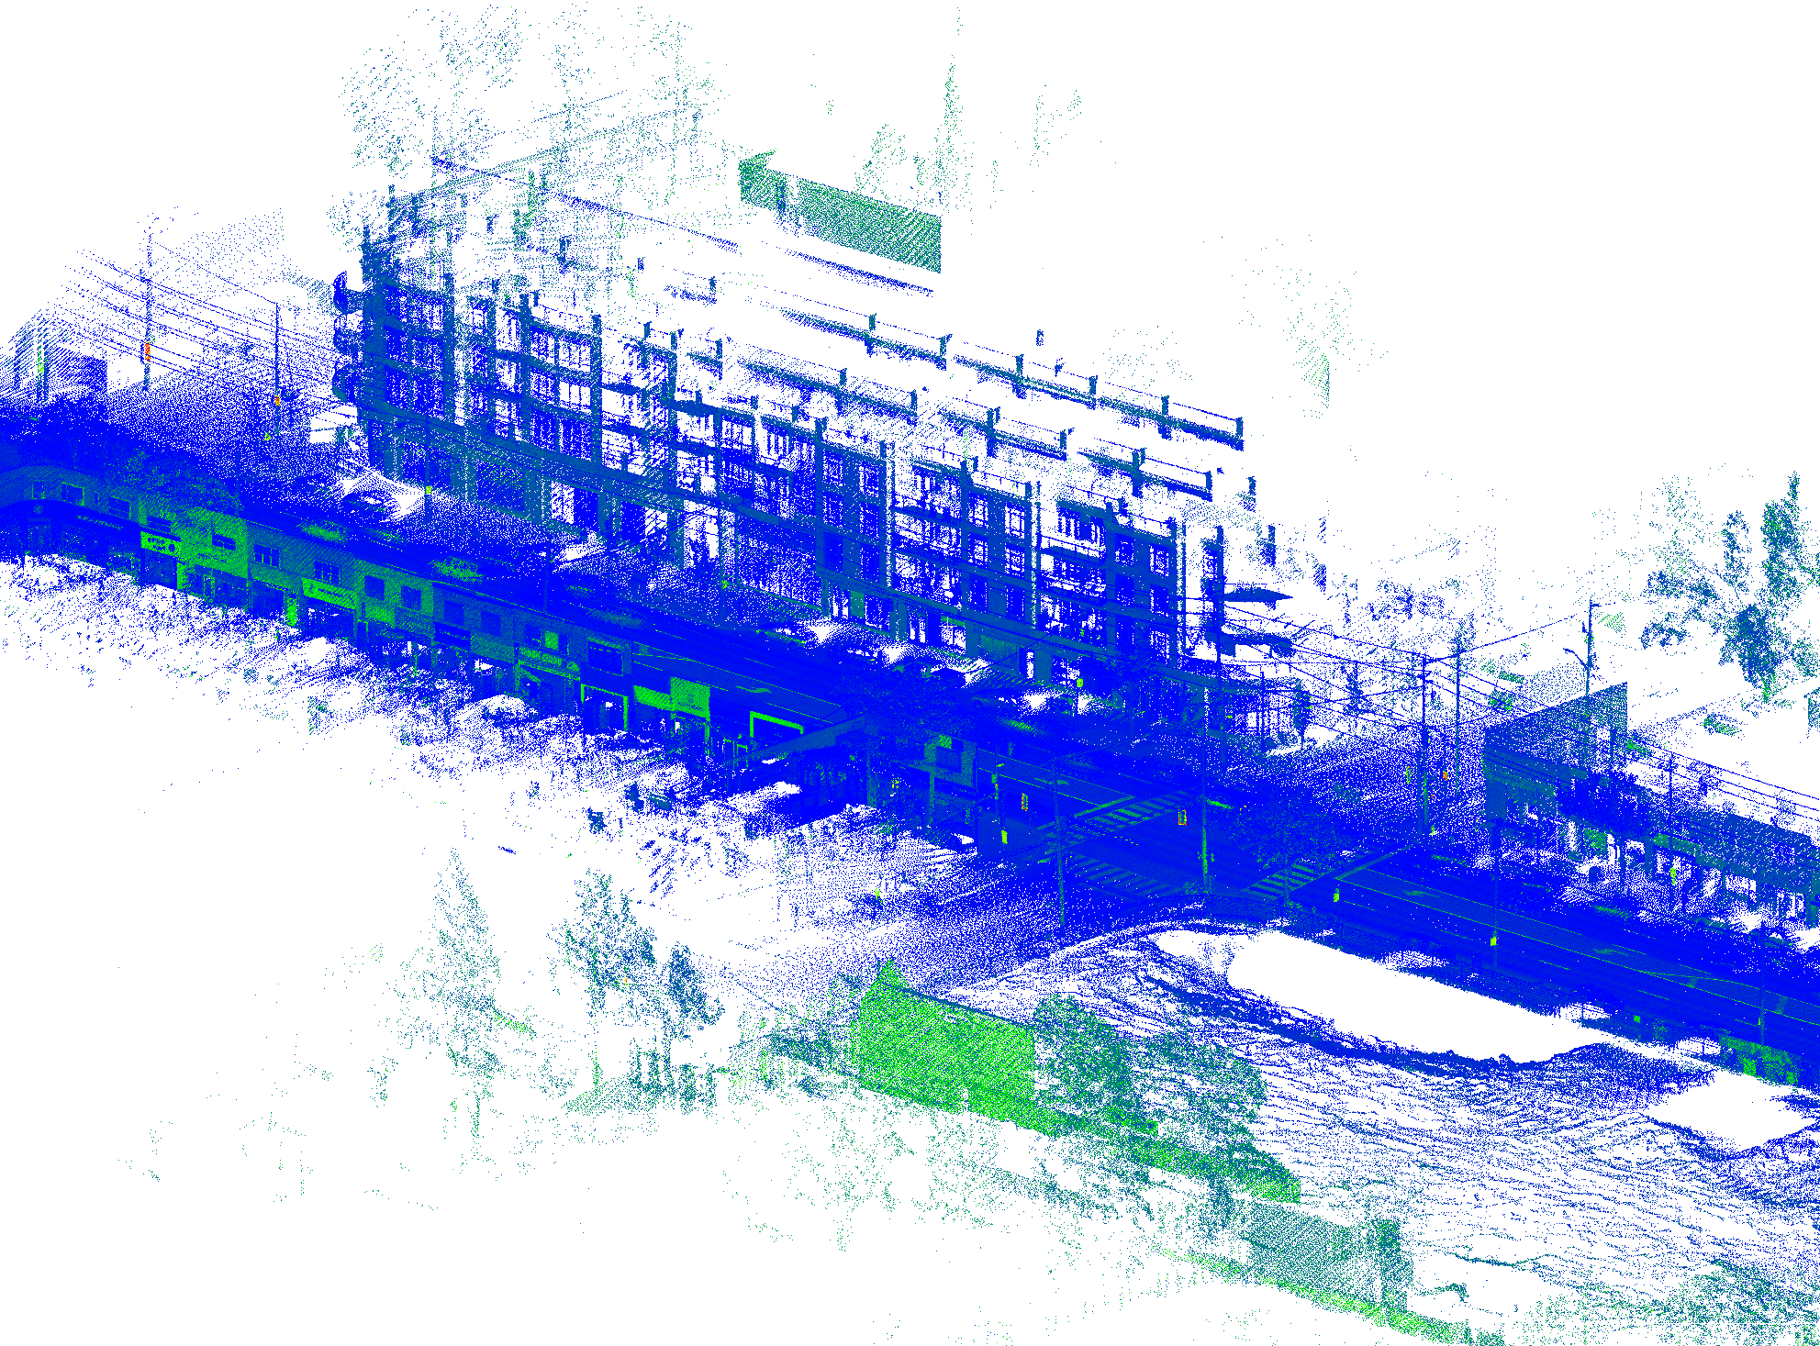
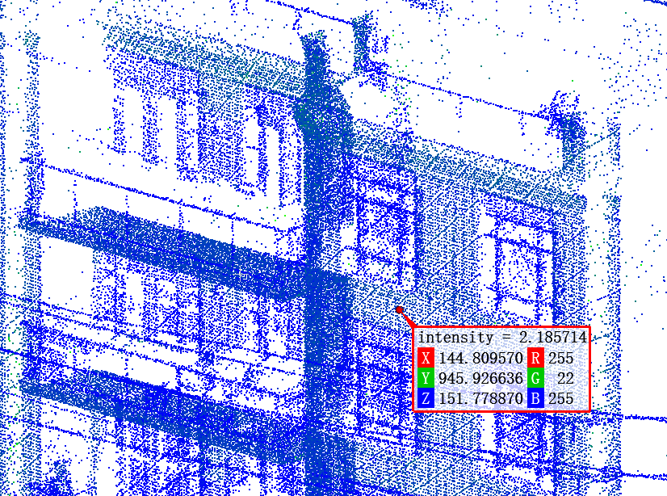
Point Clouds in Civil Engineering
What Is a Point Cloud?
A collection of points in 3D space that represents the shape of an object or site.
A CLOSER LOOK
01 / POSITION
Each point has X, Y, Z.
02 / SHAPE
Points describe geometry.
03 / ATTRIBUTES
Points may carry color.
Understanding a point requires its surrounding neighbors

Slide 4
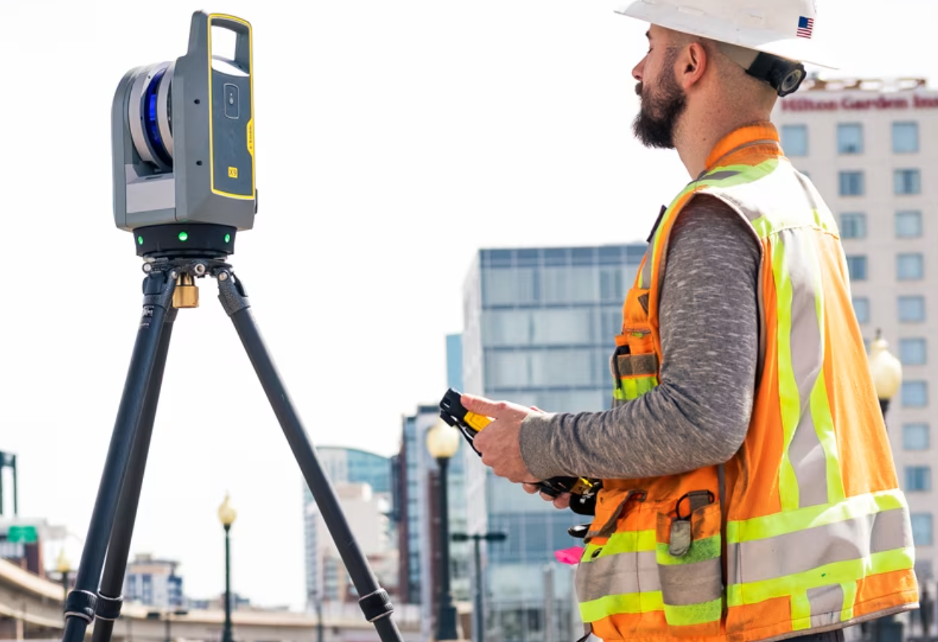

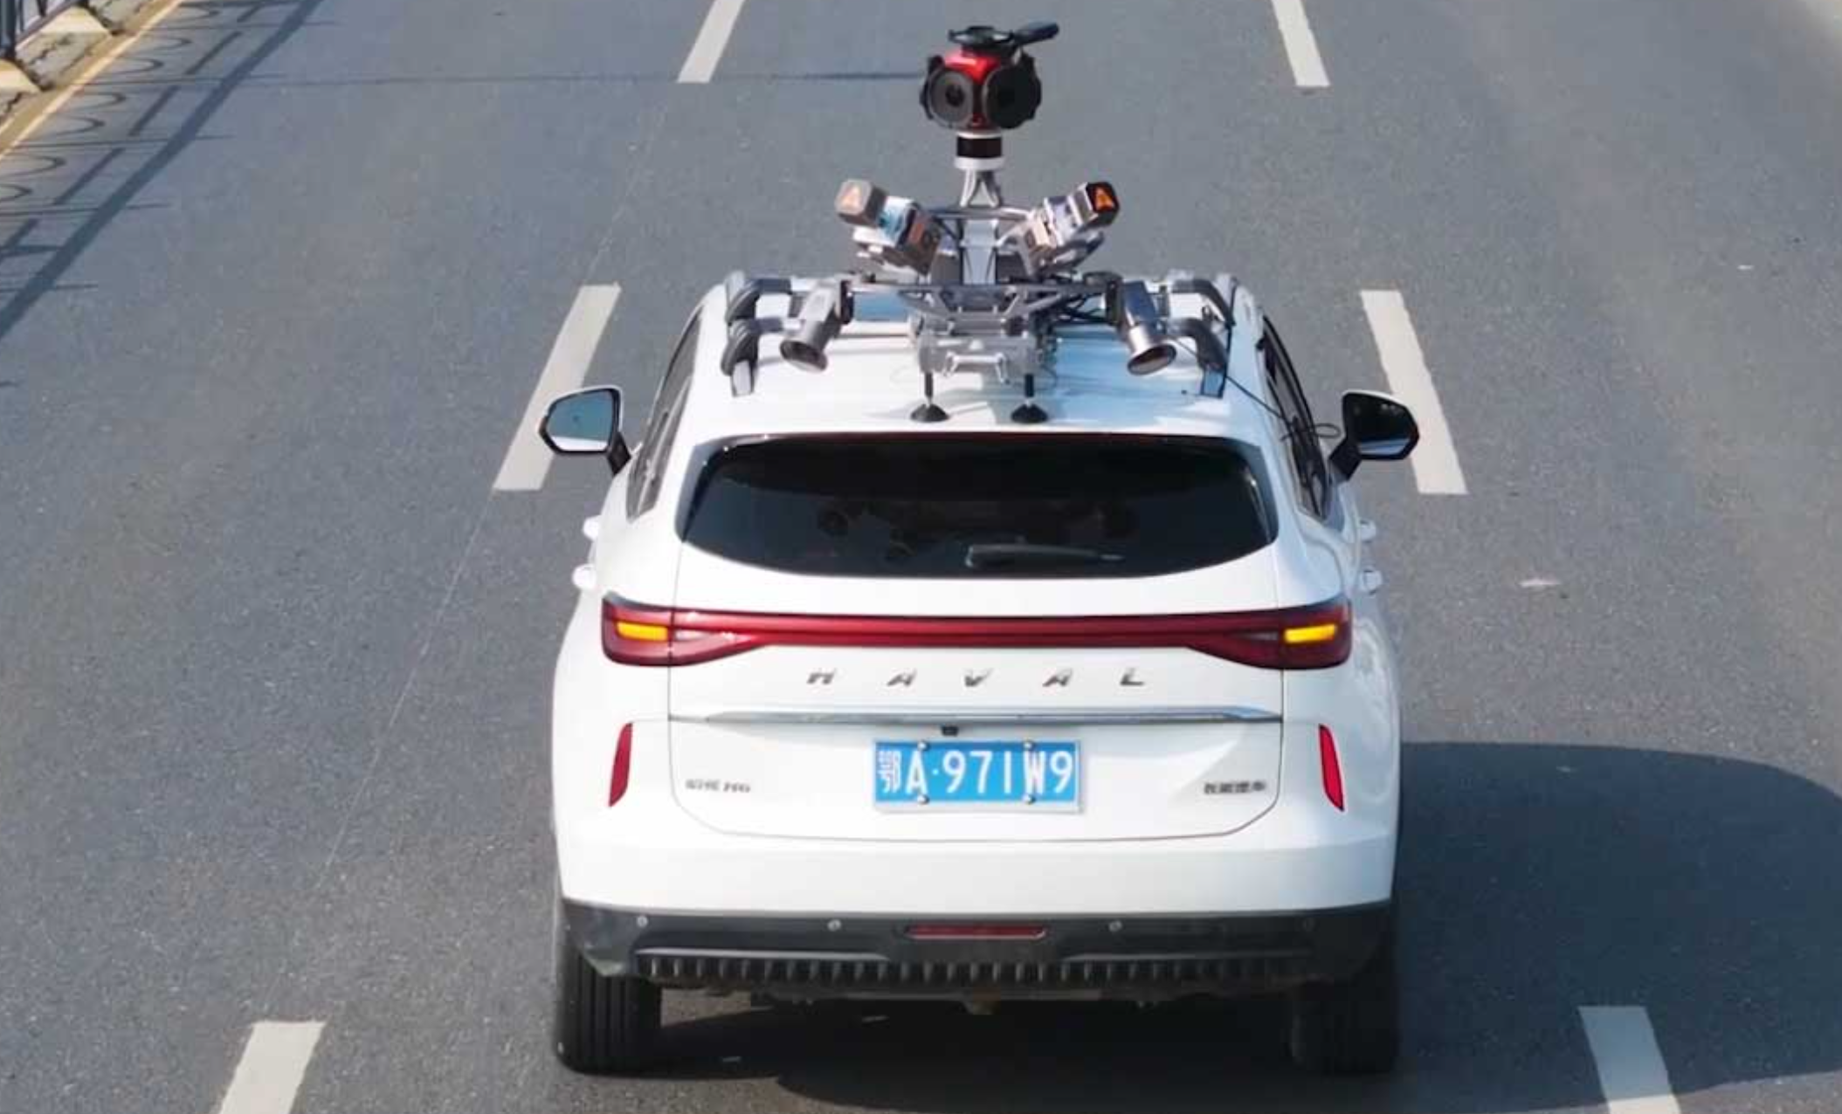
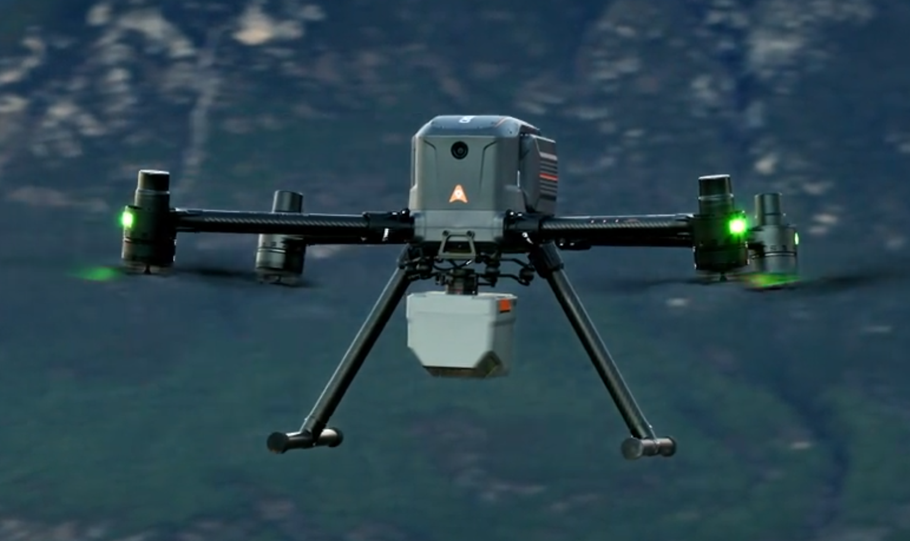
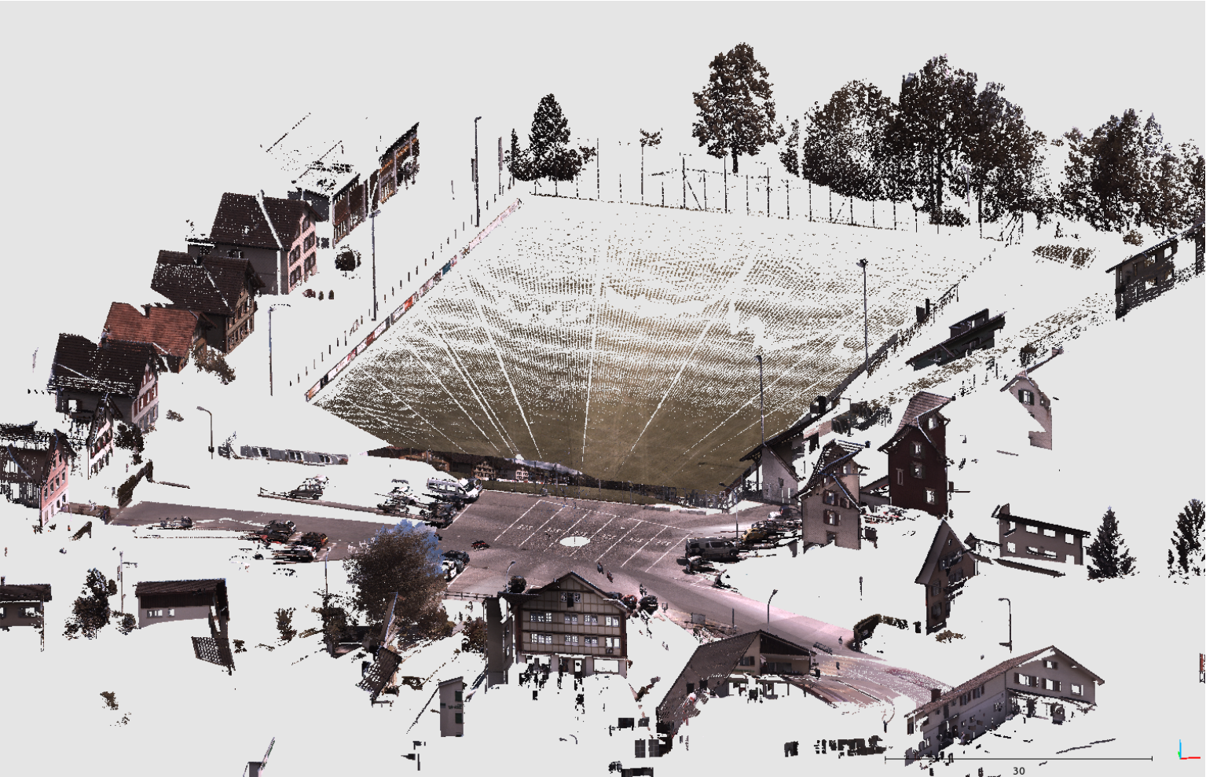
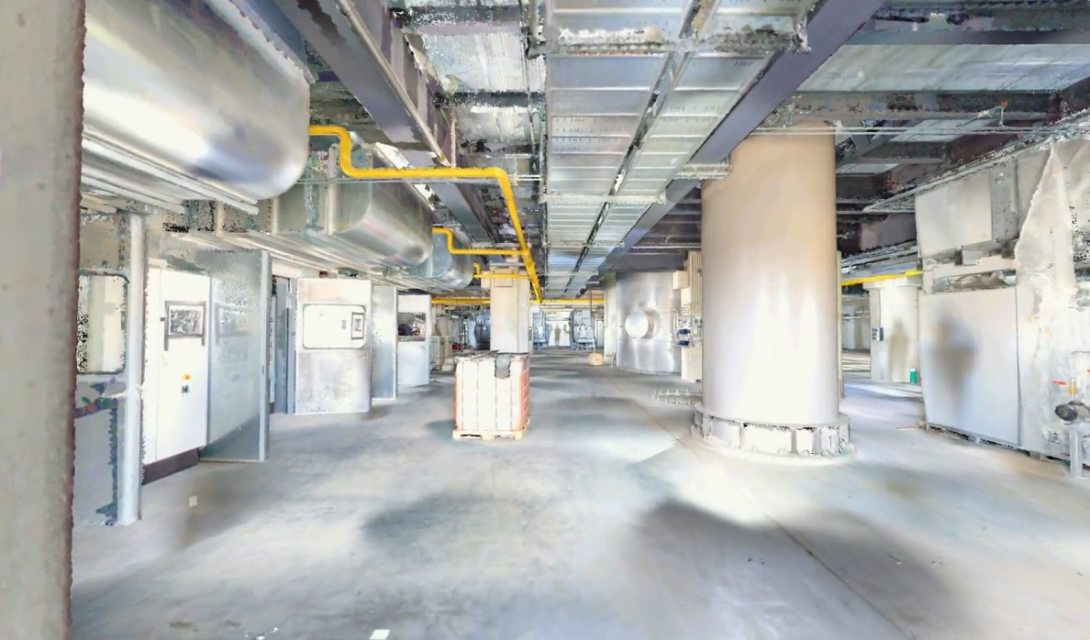
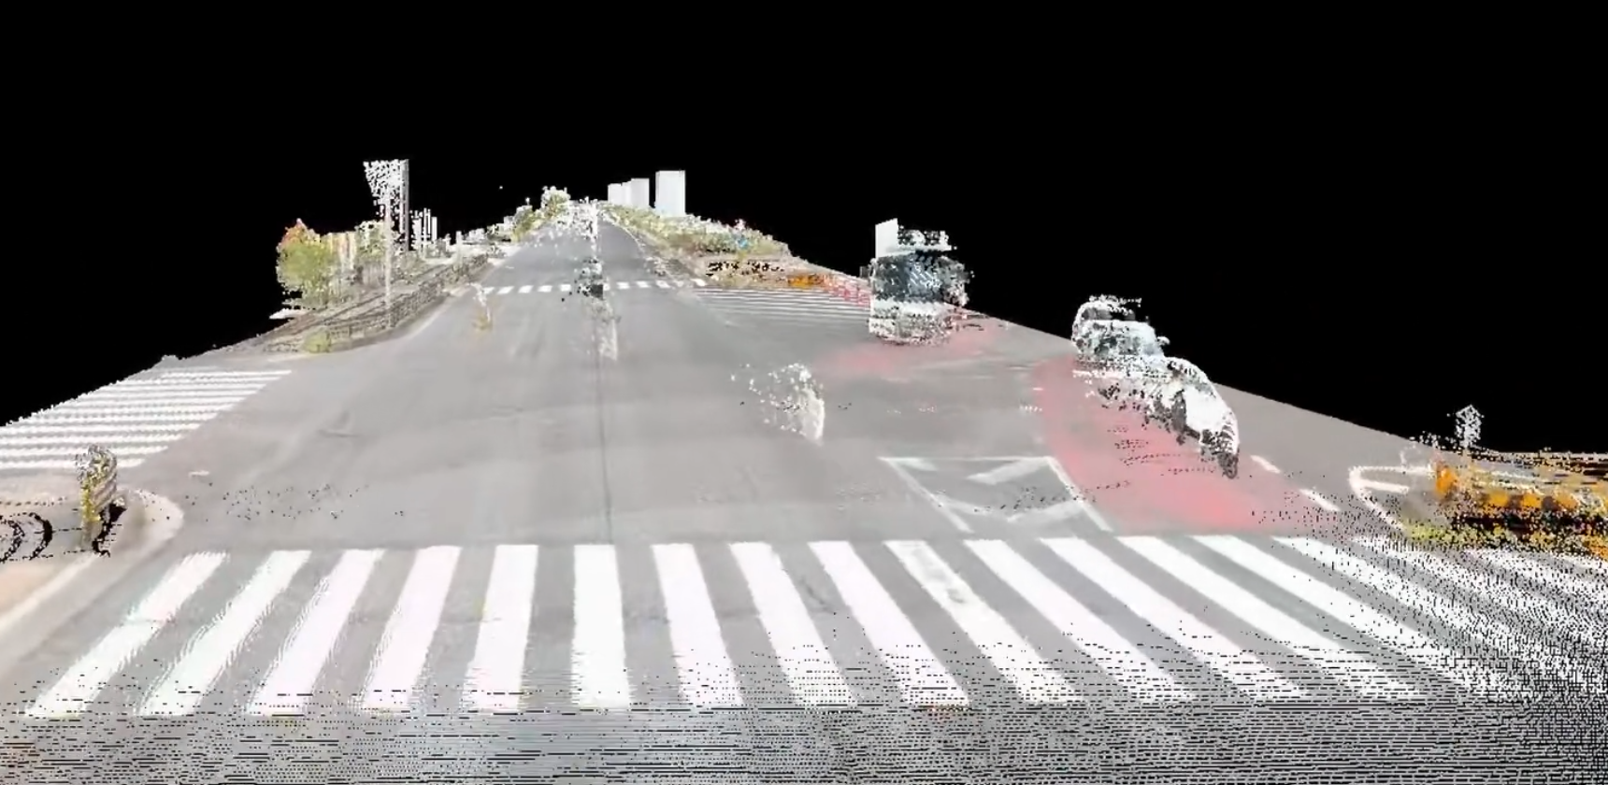
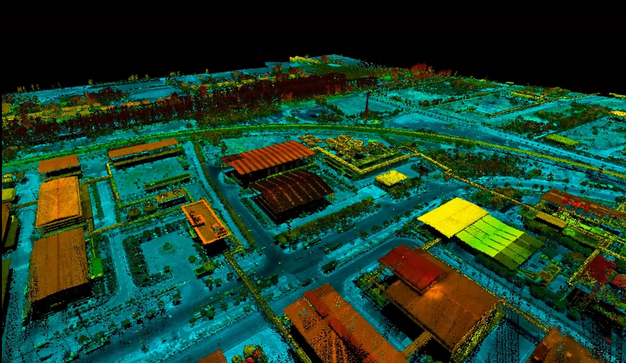
Point Clouds in Civil Engineering
How Is a Point Cloud Created?
Capturing Civil Engineering Sites.
Different equipment. Different applications. Different results.
Terrestrial Laser Scanner
Handheld Scanner
Mobile Laser Scanning System
UAV Scanning System
High accuracy
Fine geometric detail
Flexible mobility
Continuous indoor mapping
Rapid road surveying
Detailed roadside mapping
Wide-area coverage
Large-scale terrain mapping

Slide 5
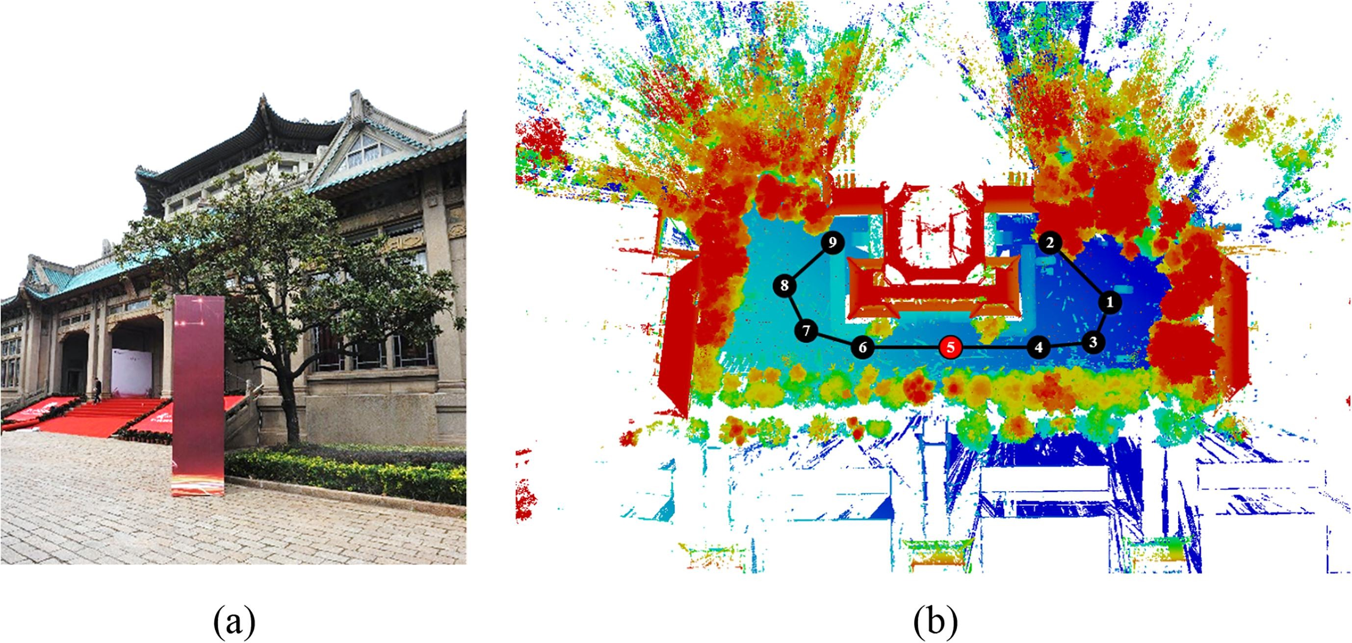
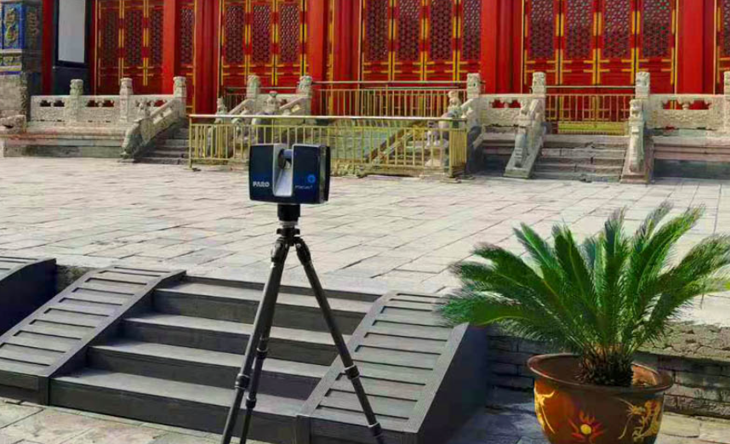
Point Clouds in Civil Engineering
How Is a Point Cloud Created?
A representative example: Terrestrial laser scanning of a building.
01 / Site planning
Inspect the site and select scan positions for sufficient coverage.
02 / Laser scanning
Scan the site from multiple positions to capture its 3D geometry.
03 / Point cloud registration
Align and merge individual scans into a unified point cloud.
Multiple viewpoints help reveal more of the site

Slide 6
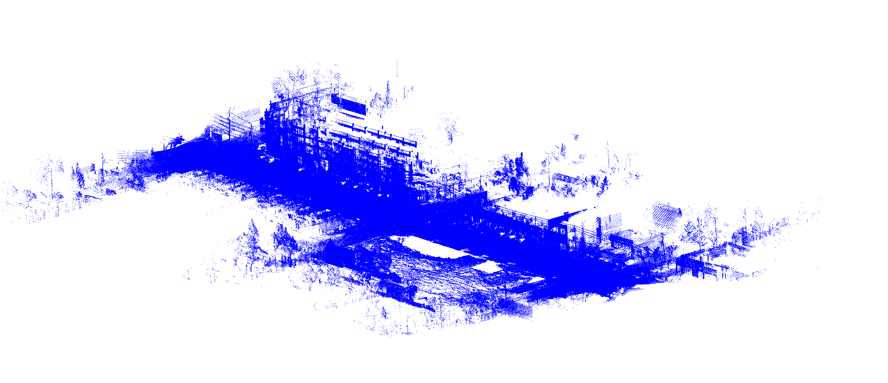
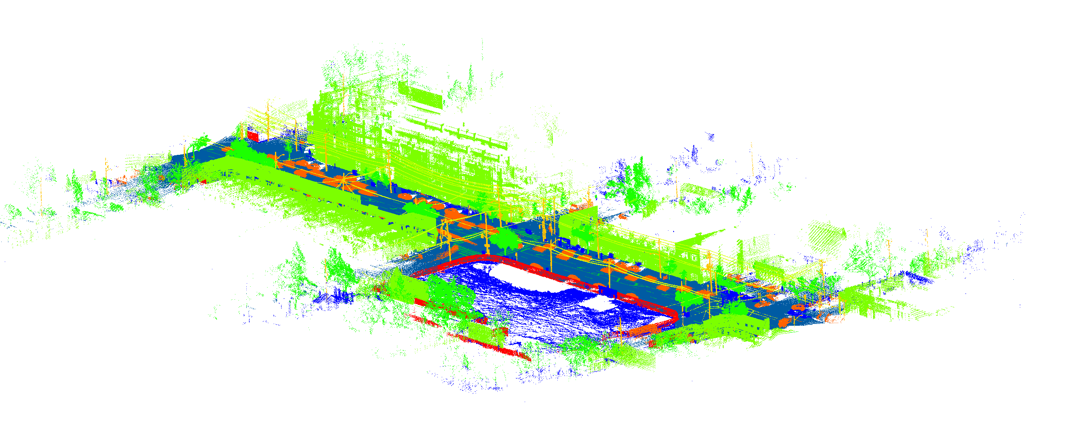
Point Clouds in Civil Engineering
What Is Semantic Segmentation?
Assign a category label to every point.
INPUT / Point cloud
OUTPUT / Labeled point cloud
Semantic
Segmentation
A cluttered set of points
A set of points labeled by category
Point positions
Geometric structure
No semantic labels
Point-wise labels
Color-coded classes
Recognizable categories
Same points. Added meaning.

Slide 7
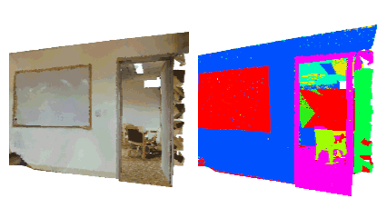
Point Clouds in Civil Engineering
How Does Semantic Segmentation Work?
01
Point Cloud Input
Import the scanned 3D point
cloud.
From raw point clouds to labelled structural components
02
Data Preprocessing
Remove noise and prepare the
points for analysis.
03
Feature Extraction
Learn geometric and spatial features from the points.
04
Point Classification
Assign a semantic label to each point.
05
Segmentation Output
Display the labelled components
in different colours.

Slide 8
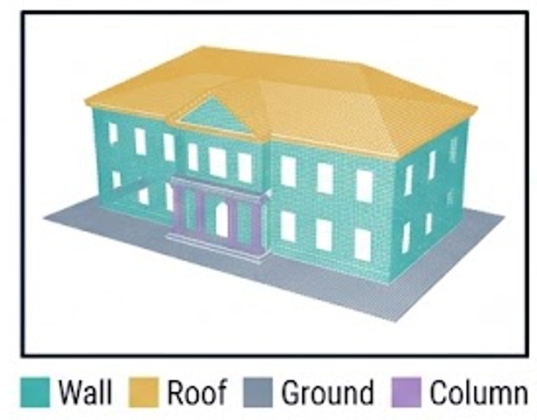
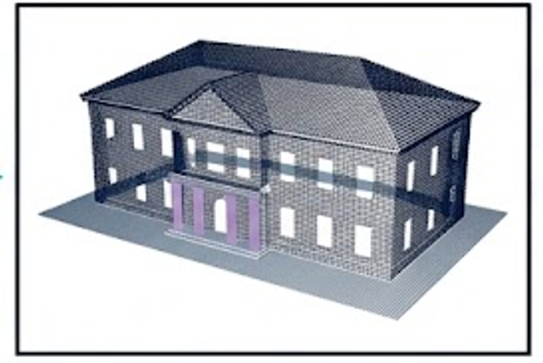
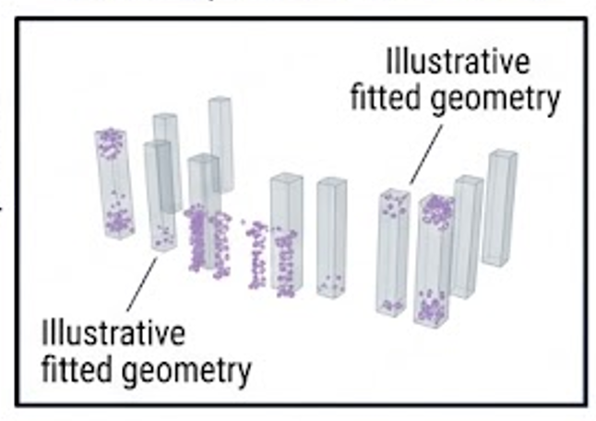
Point Clouds in Civil Engineering
Why Do We Need Semantic Segmentation?
From 3D geometry to information for engineering tasks.
01 / Semantic Segmentation
Label each point to identify different structural components.
02 / Extract Structural Information
Extract the geometry and positions of identified components.
03 / Analyze Structural Information
Use the extracted information to assess structural conditions and detect changes
Segmentation supports later tasks

Slide 9
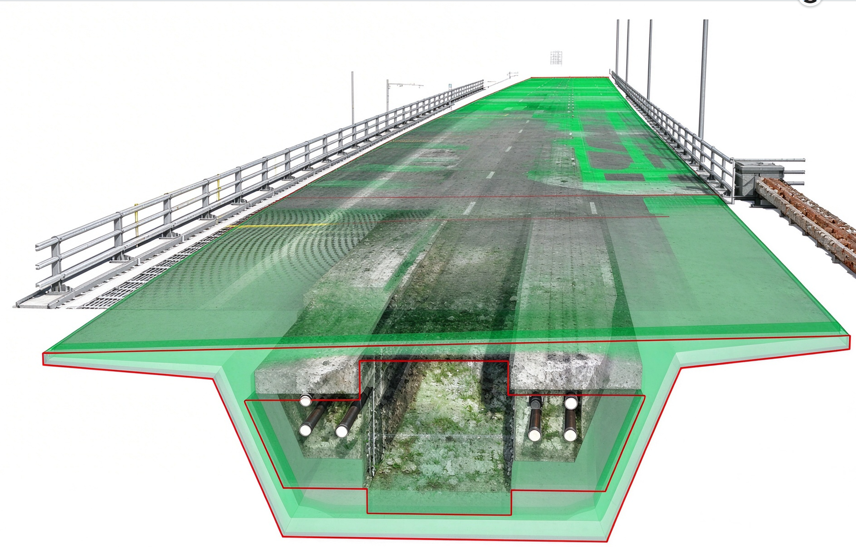
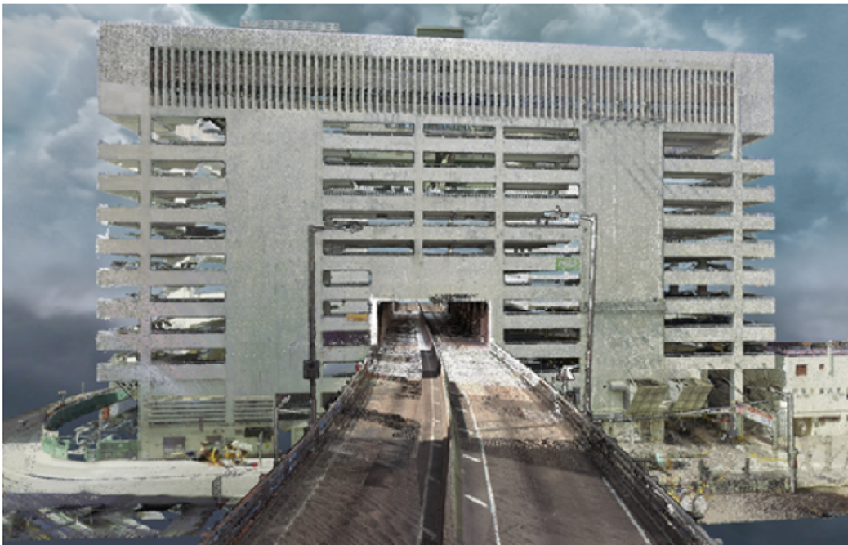
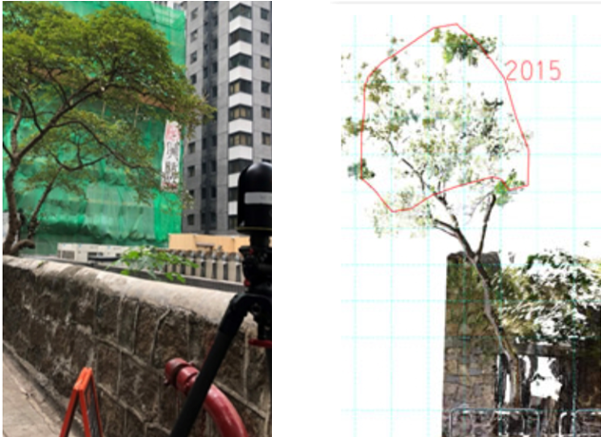
Point Clouds in Civil Engineering
Real-World Construction Case Studies
These examples highlight practical applications of laser scanning in Hong Kong.
01 / Building Information Modelling
Shenzhen Bay Bridge scans supported asset information modelling.
02 / Demolition Documentation
Scans documented the demolition of Yau Ma Tei Car Park Building.
03 / Stonewall Tree Monitoring
The Highways Department used tree scans to guide pruning and reinforcement.
From point clouds to engineering insights

Slide 10
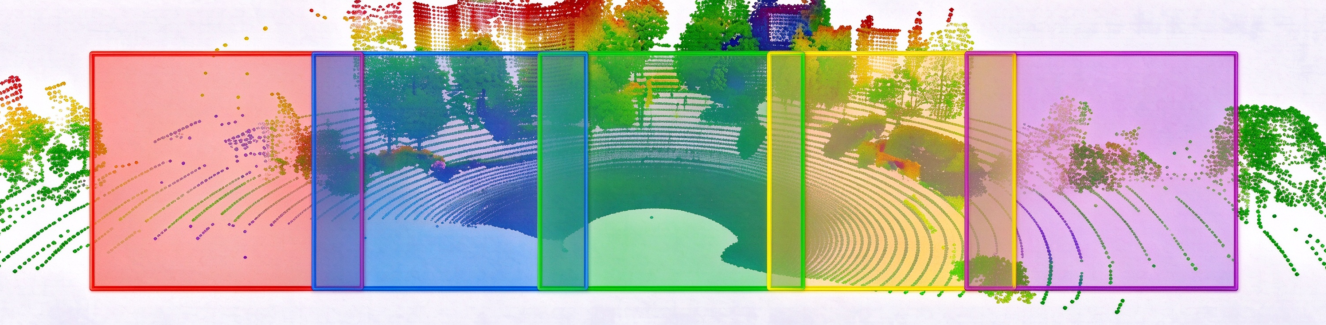
Point Clouds in Civil Engineering
Assignment: Block Size & Stride Comparison
Indoor Point Cloud Semantic Segmentation
What Will You Do?
Test different combinations of Block Size and Stride. Compare Overall Point Accuracy, Room mIoU, and the IoU of one selected class from ceiling, floor, wall, or column. (Please refer to the assignment instructions for details.)
Why it matters: Understand how block size and overlap affect overall and class-specific segmentation performance, and use the results to guide parameter selection.
What Do the Parameters Mean?
Block Size: The horizontal size of each spatial block, in meters.
Larger blocks provide more surrounding context to help identify objects, but with a fixed number of sampled points, they may capture less fine detail.
Stride: The distance between neighboring block positions, in meters.
Smaller strides increase overlap, allowing predictions from multiple blocks to be combined for each point, which may reduce errors near block boundaries.
Data
Input: A room point cloud with XYZ coordinates.
Source: Area_5_office_1.npy from the S3DIS[1] indoor point cloud dataset.
Ground truth: Semantic labels provided for evaluation.
Block Size
Block Size
[1] Armeni, Iro, et al. "3d semantic parsing of large-scale indoor spaces." Proceedings of the IEEE conference on computer vision and pattern recognition. 2016.
Stride
Stride

Slide 11
Thank You!

Slide 12
Assignment 6 Point Cloud Segmentation and Robot Path Planning
Guidebook: Path Planning
Prof. Yantao Yu
Wenyu Li
The Hong Kong University of Science and Technology (HKUST)

Slide 13
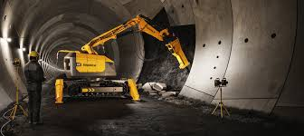

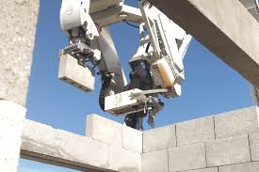
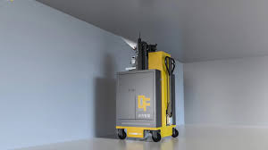
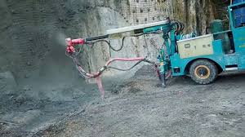
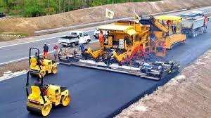
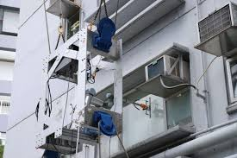
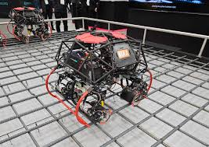
Background – Construction Robot
In the construction industry, robots has been widely applied to various tasks.
construction robots in civil engineering
construction robots in building construction
tunnel boring robot
excavation robot
bricklaying robot
wall spraying robot
concrete spraying robot
asphalt paving robot
facade installation robot
rebar tying robot

Slide 14
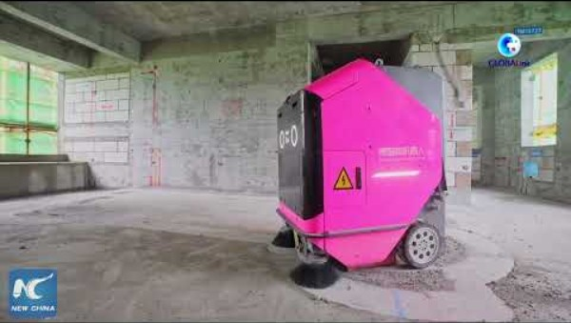
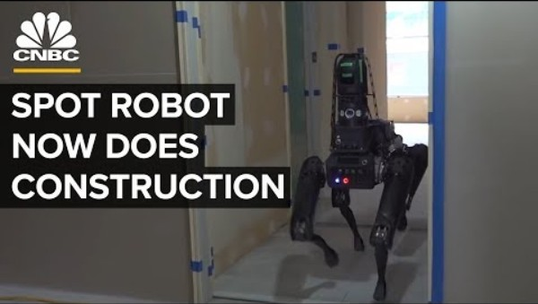
Background – Path Planning
The automated movement of robots without manual remote control relies on the path planning technologies.
BDR Robots for executing construction tasks
Boston robots for automated inspection

Slide 15
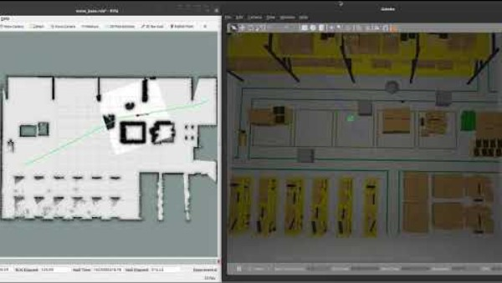
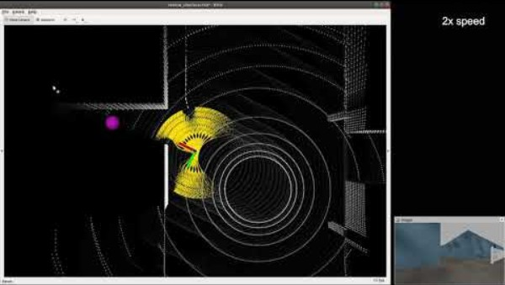
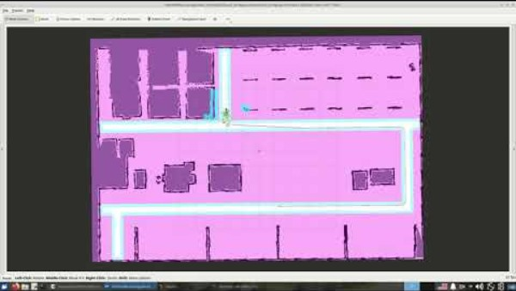
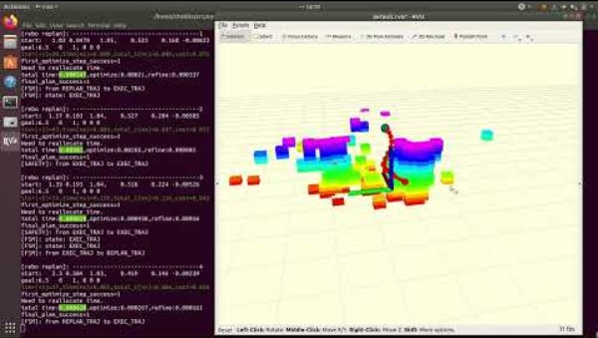
Path Planning Solutions
Classic methods are primarily focused on 2D navigation for ground robots. However, modern algorithms are capable of planning in 3D space or for unmanned aerial vehicles (UAVs).
ROS1 Navigation Stack(2d, for UGV)
CMU exploration (3d, for UGV and UAV)
ROS2 Nav2(2d, for UGV)
ego planner (3D,for UAV)

Slide 16



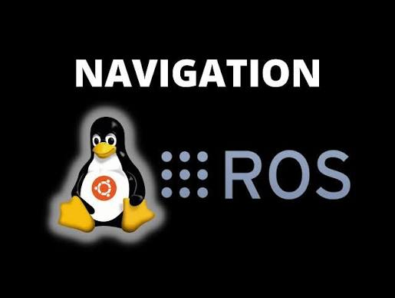
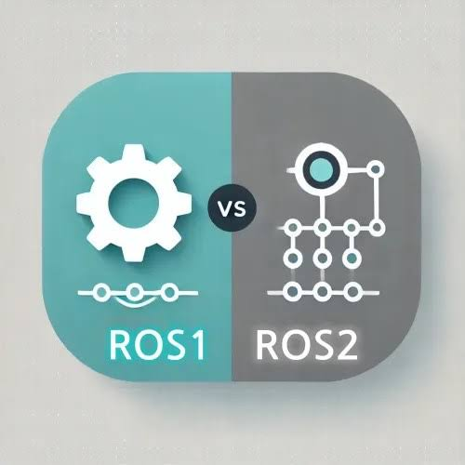
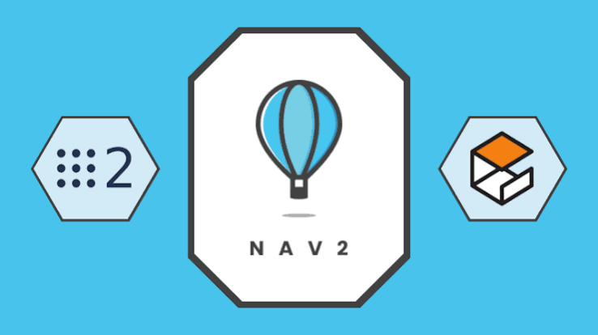
ROS (Robot Operating System )
What is ROS?
ROS is an open-source collection of tools, libraries, and communication frameworks that enables robot software modules to work together..
ROS is not an operating system (OS). ROS is robotics middleware that runs on top of an operating system.
How to use ROS?
ROS is primarily used on Ubuntu, with limited support for other systems.
However, virtualization and containerization make it accessible to Windows and macOS users through Docker or WSL!
ROS navigation and planning
ROS provides a common communication framework and hardware–software interfaces for robot navigation and path planning.
Integration with simulation platforms allows learners to test algorithms in virtual environments before deploying them on real robots.
ROS1 and ROS2
ROS 2 is the modern, redesigned successor to ROS 1. ROS 2 offers better support for real-time communication, security, and multi-robot coordination.
Both have been widely used in practice; however, with ROS 1 reaching end of life in May 2025, ROS 2 will become the standard for future development and deployment.

Slide 17
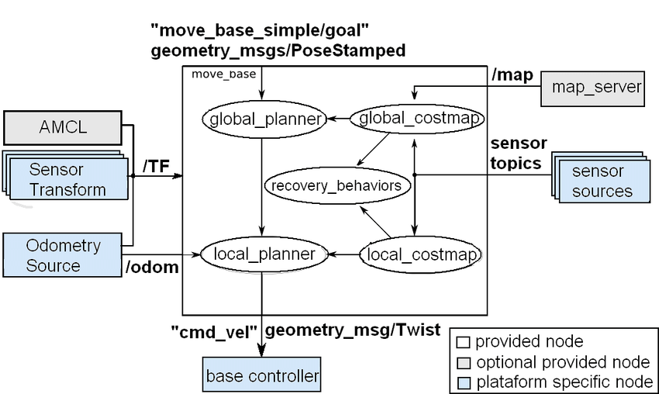
ROS navigation stack
Key Modules:
Localization: the current position of the robot.
Mapping: the surrounding environment.
Planning: Schedule a path and velocity command.
Localization and Mapping functions are usually provided by SLAM (Simultaneous Localization and Mapping)
Others:
Control: A driver package provided by the robot will receive the /cmd_vel velocity commands to drive the platform.
Sensing: Sensors provide images or laser scanning to the robot.
Mapping
Localization
Planning
Sensing
Control

Slide 18
Experiment
Preparation before class: Install basic environments on your computer.
Experiments in Simulation: start the simulation in docker and try to navigate it. You can also finish the assignment at this time.
Experiments on Real Robots: navigate the robot and record pictures or videos.

Slide 19
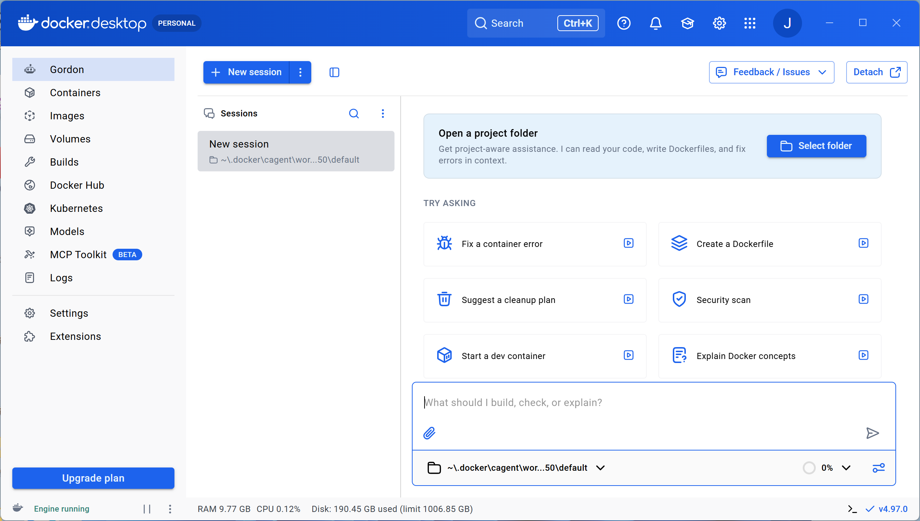
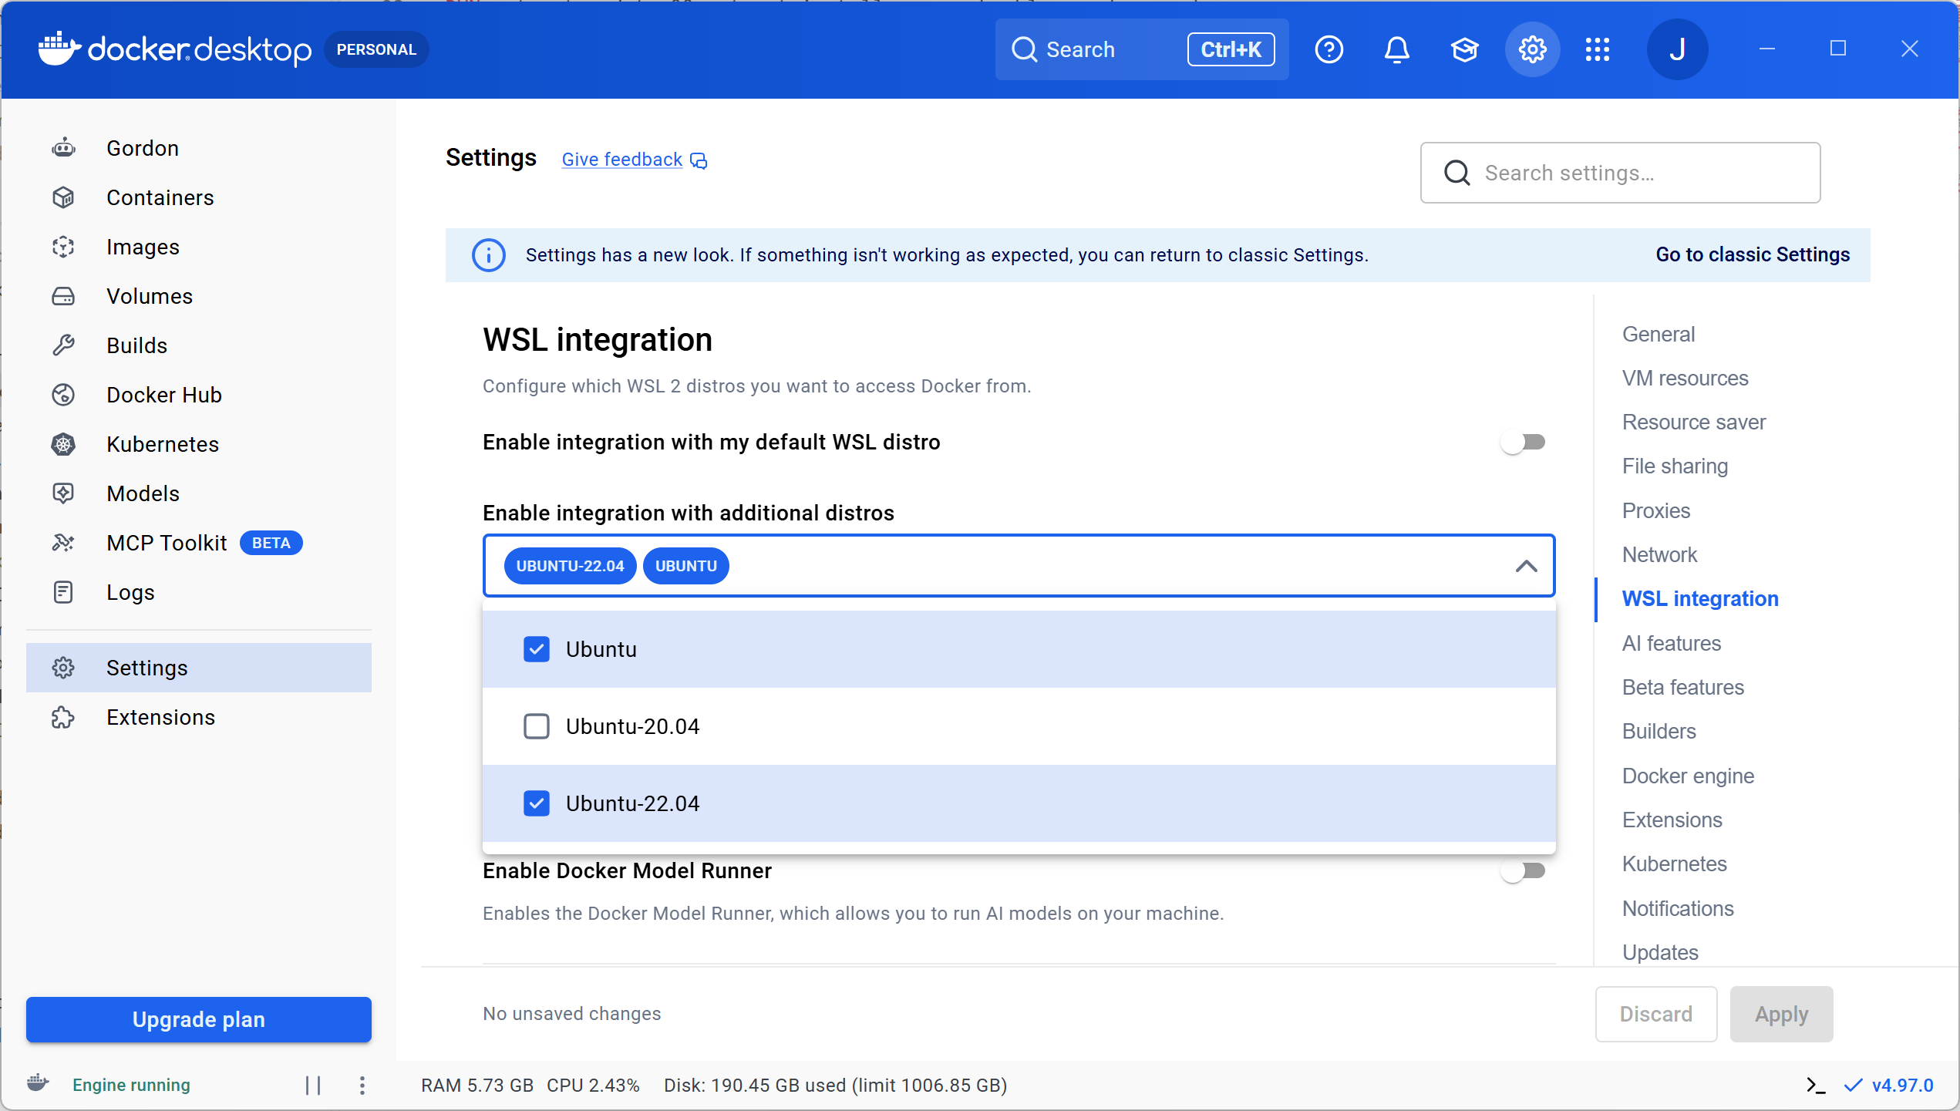
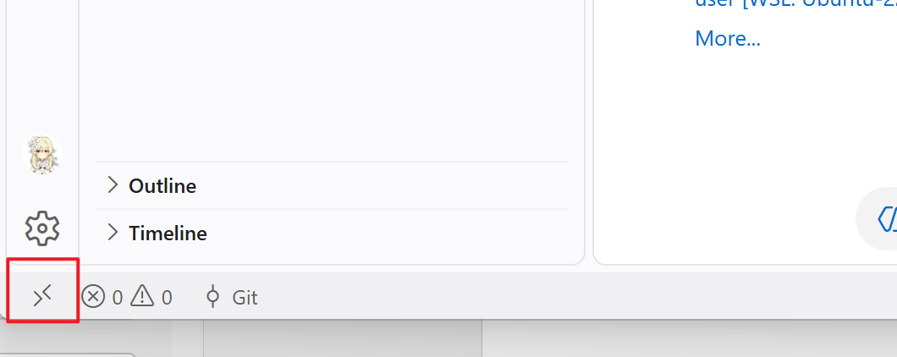
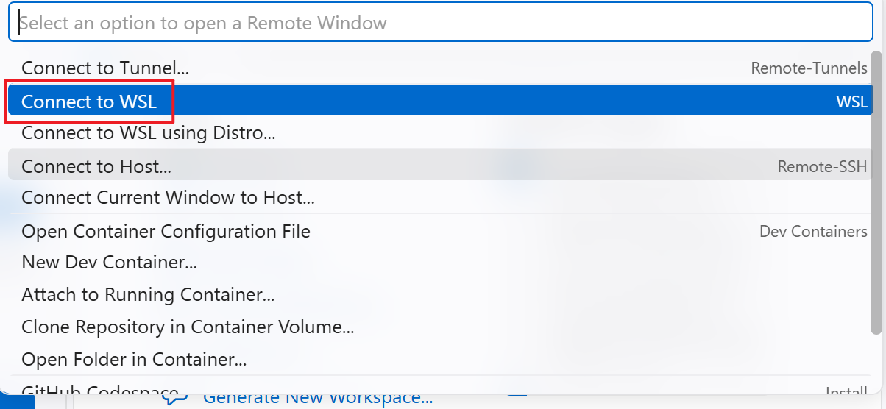
Preparation before class
1.Download and install docker desktop:
https://docs.docker.com/desktop/
Set wsl integration
2.Install wsl on windows
https://learn.microsoft.com/en-us/windows/wsl/install
Just try:
wsl –install
Then set user name and password
3.Open wsl in vscode
Open docker desktop
4.Test docker in wsl
Set wsl integration

Slide 20
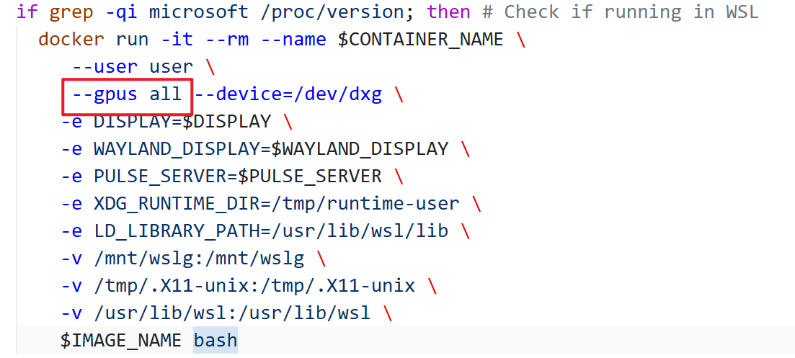
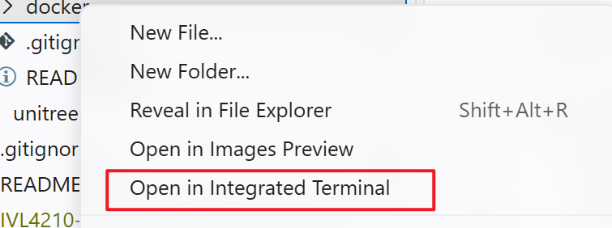
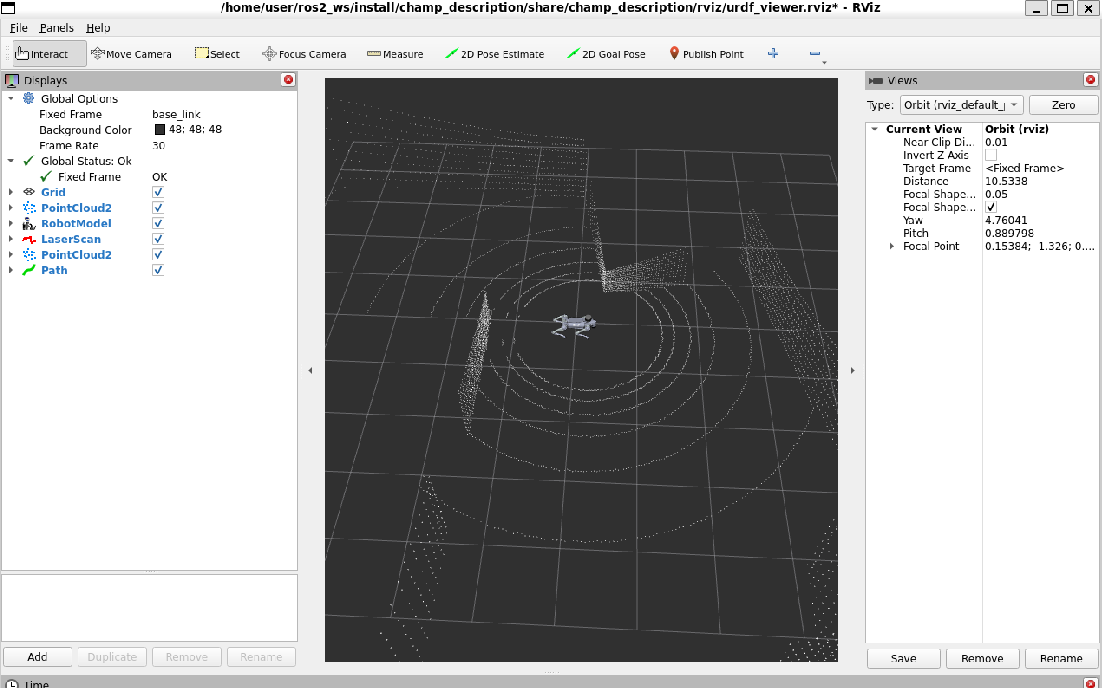
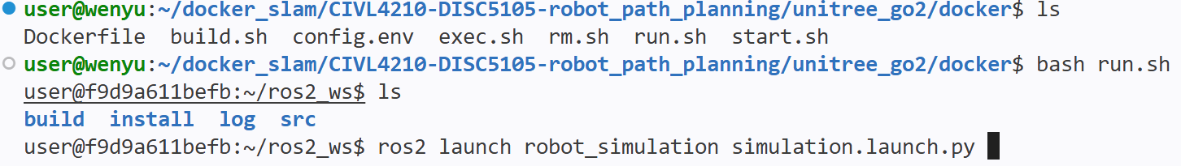
Experiments in Simulation
Download the experiment environment:
Wheeled-robot, ros1
docker pull joriswenyuli/ros_agilex_scout_sim:latest
Robot dog, ros2
docker pull joriswenyuli/ros_unitree_go2_sim:latest
In docker folder
If you do not have nvidia gpu on your compuer, delete --gpus all in the script
Open docker folder and run: bash run.sh
Test the environment:
ros2 launch robot_simulation simulation.launch.py

Slide 21




Experiments in Simulation
Open it use vscode
Finish the preparation.
Install Container Tools Extension in vscode
bash run.sh will create a container. Ctrl+d to shut it down and re-open it use vscode.
You should run the commands in ros2_ws folder.
Start the container
Open container use vscode
Open the ros2_ws folder
Open new terminal

Slide 22
Experiments in Simulation
How to get the script:
Copy the provided script into wsl
find it https://github.com/yantaolab/Autonomous-Construction-and-Robotics.git
create a new file in wsl
copy the content in run.sh into your created file
rename it into run.sh
use bash run.sh
2. or, you can directly download it into wsl
git clone https://github.com/WenyuLWY/CIVL4210-DISC5105-robot_path_planning.git
Use sudo apt install git ,if you do not have git in your wsl
cd to the corresponding docker folder
use bash run.sh

Slide 23



Experiments in Simulation
Steps: simulation environments -> localization ->planning
Use the following commands:
Agilex Scout,ROS1, 2d planning
roslaunch robot_simulation simulation1.launch
roslaunch robot_simulation localization1.launch
roslaunch robot_simulation planning1.launch
Agilex Scout,ROS1, 3d planning
roslaunch robot_simulation simulation2.launch
roslaunch robot_simulation localization2.launch
roslaunch robot_simulation planning2.launch
Unitree Go2 ,ROS2, 3d planning
ros2 launch robot_simulation simulation.launch.py
ros2 launch robot_simulation localization.launch.py
ros2 launch robot_simulation planning.launch.py
Publish 2d goal point
Publish 3d nav goal point

Slide 24

Help - keyboard control
ROS1-noetic:
sudo apt-get install ros-noetic-teleop-twist-keyboard
rosrun teleop_twist_keyboard teleop_twist_keyboard.py
ROS2-humble:
sudo apt-get install ros-humble-teleop-twist-keyboard
ros2 run teleop_twist_keyboard teleop_twist_keyboard

Slide 25



Help - rqt
ROS1-noetic and ROS2-humble :
rqt
TF tree
Node graph
Topic Monitor

Slide 26
Help - commands
Topic list:
ROS1-noetic:
rostopic list
ROS2-humble:
ros2 topic list
Topic info:
ROS1-noetic:
rostopic echo /your_topic
ROS2-humble:
ros2 topic echo /your_topic
After modify the code:
ROS1-noetic,in catkin_ws:
catkin build
then
source de vel/setup.bash
ROS2-humble, in ros2_ws :
colcon build
or
colcon –symlink-install
then
source install/setup.bash
Tf transform:
ROS1-noetic:
rosrun tf tf_echo /source_frame /target_frame
ROS2-humble:
ros2 run tf2_ros tf2_echo source_frame target_frame

